Slide 1
Does it matter how your friends vote?
Ed Fieldhouse
University of Manchester
www.britishelectionstudy.com

Slide 2
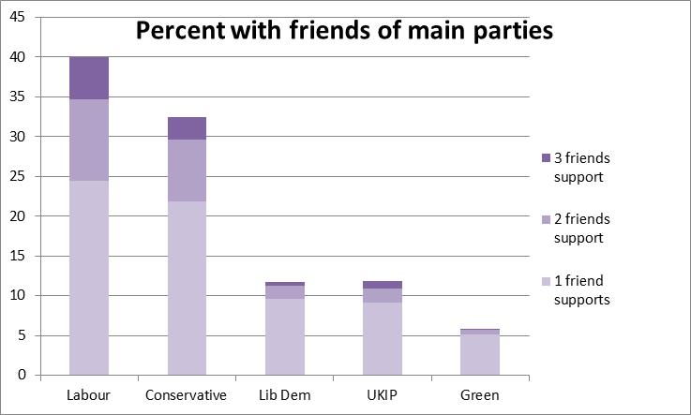
UKIP fail to ‘go viral’
www.britishelectionstudy.com
Notes:
Compared to vote share con 29; lab 29; ukip 14; ld 6.
Yougov showed that A significant minority of voters would find it hard to stay friends with a UKIP convert. We find that not that many have UKIP friends (only 10%)

Slide 3
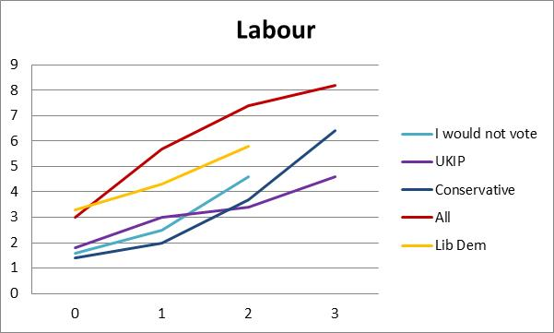
How likely is it you’d ever vote for party by the number of supporter friends
www.britishelectionstudy.com
Notes:
Does it matter?
We ask how likely is it that you would ever vote for each of the following parties?
Sam pattern for grenss (all voters) but not enough people with green friends to break down by party
Green 2.8; 5.8; 6.7; 7.6

Slide 4
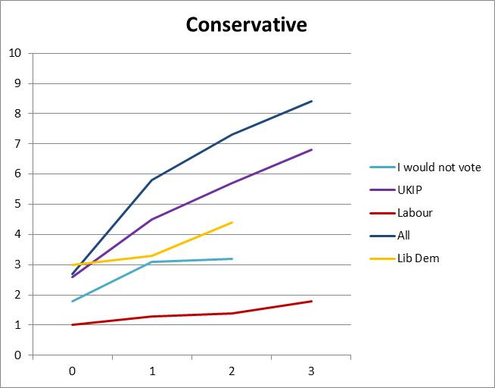
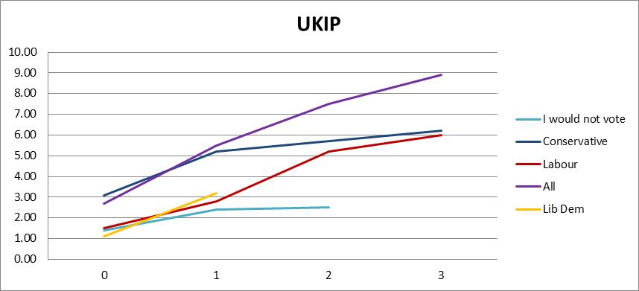
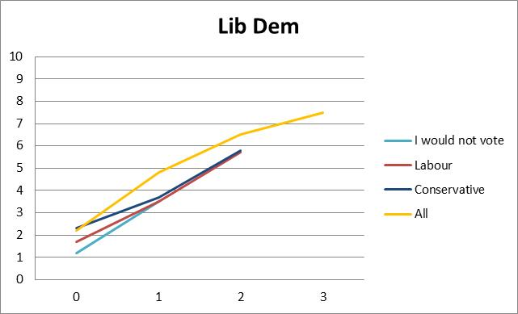
How likely is it you’d ever vote for party by the number of supporter friends
www.britishelectionstudy.com
Notes:
Does it matter?
We ask how likely is it that you would ever vote for each of the following parties?
Sam pattern for grenss (all voters) but not enough people with green friends to break down by party
Green 2.8; 5.8; 6.7; 7.6

Slide 5
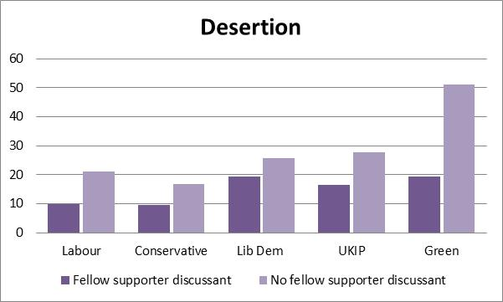
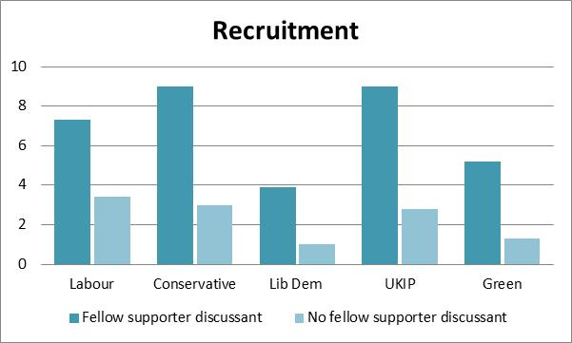
Changing vote intention – June to September
www.britishelectionstudy.com

