Slide 1


How big is the representation gap?
Cees van der Eijk
University of Nottingham
www.britishelectionstudy.com

Slide 2

Democratic representation
Adequate representation requires that electoral ‘supply’ (the parties on the ballot) covers electoral ‘demand’ (what citizens want).
Thus, citizens who do not recognise their views in any of the parties on offer are not well represented.
The proportion of such citizens indicates the extent of a possible ‘representation deficit’. Is there such a deficit in Britain, and how large is it?
www.britishelectionstudy.com

Slide 3
How do we measure this?
We use so-called ‘propensity to vote’ indicators (PTVs) using the following survey question:
  “How likely is it that you would ever vote for each of the following parties?”
  Conservatives / Labour / Liberal Democrats /
  SNP (only in Scotland) / Plaid Cymru (only in Wales) / UKIP / Greens / BNP
Responses expressed on scale from 0 to 10.
Data are from BESIP June 2014.
www.britishelectionstudy.com

Slide 4
 | At least one party scoring 10
Conservatives and Labour | 31
www.britishelectionstudy.com

Slide 5
 | At least one party scoring 10 | At least one party scoring 9 or higher
Conservatives and Labour | 31 | 39
www.britishelectionstudy.com

Slide 6
 | At least one party scoring 10 | At least one party scoring 9 or higher | At least one party scoring 8 or higher
Conservatives and Labour | 31 | 39 | 51
www.britishelectionstudy.com

Slide 7
 | At least one party scoring 10 | At least one party scoring 9 or higher | At least one party scoring 8 or higher
Conservatives and Labour | 31 | 39 | 51
Conservatives, Labour, LibDem | 34 | 43 | 55
www.britishelectionstudy.com

Slide 8
 | At least one party scoring 10 | At least one party scoring 9 or higher | At least one party scoring 8 or higher
Conservatives and Labour | 31 | 39 | 51
Conservatives, Labour, LibDem | 34 | 43 | 55
Conservatives, Labour, LibDem, UKIP | 41 | 52 | 66
www.britishelectionstudy.com

Slide 9
 | At least one party scoring 10 | At least one party scoring 9 or higher | At least one party scoring 8 or higher
Conservatives and Labour | 31 | 39 | 51
Conservatives, Labour, LibDem | 34 | 43 | 55
Conservatives, Labour, LibDem, UKIP | 41 | 52 | 66
Conservatives, Labour, Libdem, UKIP, Greens, BNP | 43 | 55 | 68
www.britishelectionstudy.com

Slide 10
 | At least one party scoring 10 | At least one party scoring 9 or higher | At least one party scoring 8 or higher
Conservatives and Labour | 31 | 39 | 51
Conservatives, Labour, LibDem | 34 | 43 | 55
Conservatives, Labour, LibDem, UKIP | 41 | 52 | 66
Conservatives, Labour, Libdem, UKIP, Greens, BNP | 43 | 55 | 68
Conservatives, Labour, Libdem, UKIP, Greens, BNP, SNP, PC | 44 | 56 | 71
www.britishelectionstudy.com

Slide 11
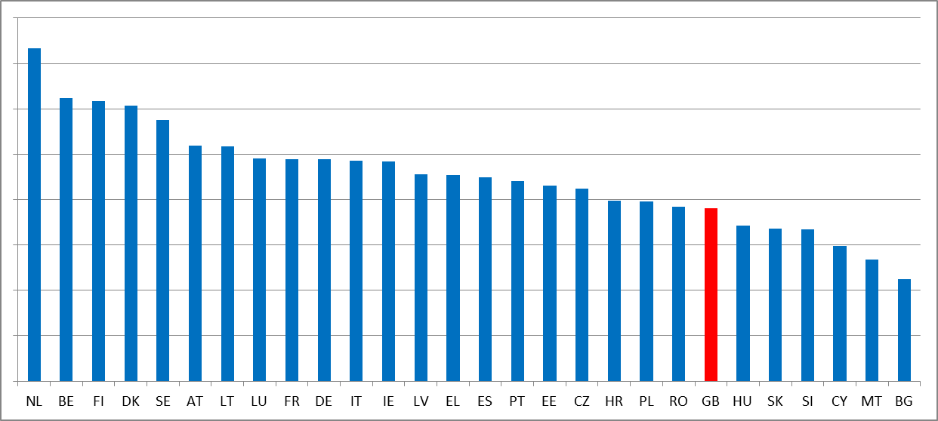
Britain in comparative perspective
Proportions of citizens who give at least one party a PTV score of 8 or higher – all EU countries
(source: European Election Study 2014)
www.britishelectionstudy.com

Slide 12
Driver of representation deficit
Perception that political parties are not very different, particularly Conservatives and Labour; in this graph in Left-Right terms
L-R Difference 0 1 2 3 4 5 6 7 8 9 10
www.britishelectionstudy.com

Slide 13
Consequences
Depressed attention, involvement and participation in politics
 | Did vote in European Parliament Election 2014 | Very likely to vote in General Election 2015 | High Political attention
At least one party scoring 8 or higher | 79% | 85% | 50
No party scoring 8 or higher | 47% | 47% | 25
www.britishelectionstudy.com

Slide 14
Conclusion
A sizeable segment of the British public sees none of the political parties as electorally attractive, and is thus not well represented
One of the most important drivers of this lack of representation is perceived lack of differentiation between the parties, particularly between the Conservatives and Labour
Consequences of this representation deficit are strongly depressed rates of attention, involvement and participation.
www.britishelectionstudy.com

