Slide 1


From which parties will the parties win votes in 2015?
Geoffrey Evans and Jon Mellon
Nuffield College
University of Oxford
www.britishelectionstudy.com
Notes:
In terms of the seats analysis, I think I've got a slightly better way to do it than in the previous email (which comes out with slightly different figures). The assumptions are:
Only English and Welsh respondents
Individual level comparison of respondents in Labour held seats and Conservative held seats
Excluding don't knows but including "I would not vote"
Weighted using full weights
UKIP support in Conservative held seats: 18%
UKIP support in Labour held seats: 14%
Further assumptions:
using recalled profile data for 2010 and 2005 vote
These seem to match up reasonably well with the panel data, but obviously a potential limitation
2010 vote of UKIP supporters in Labour seats: 39% Conservative/18% Labour
2005 vote of UKIP supporters in Labour seats: 31% Conservative/30% Labour

Slide 2

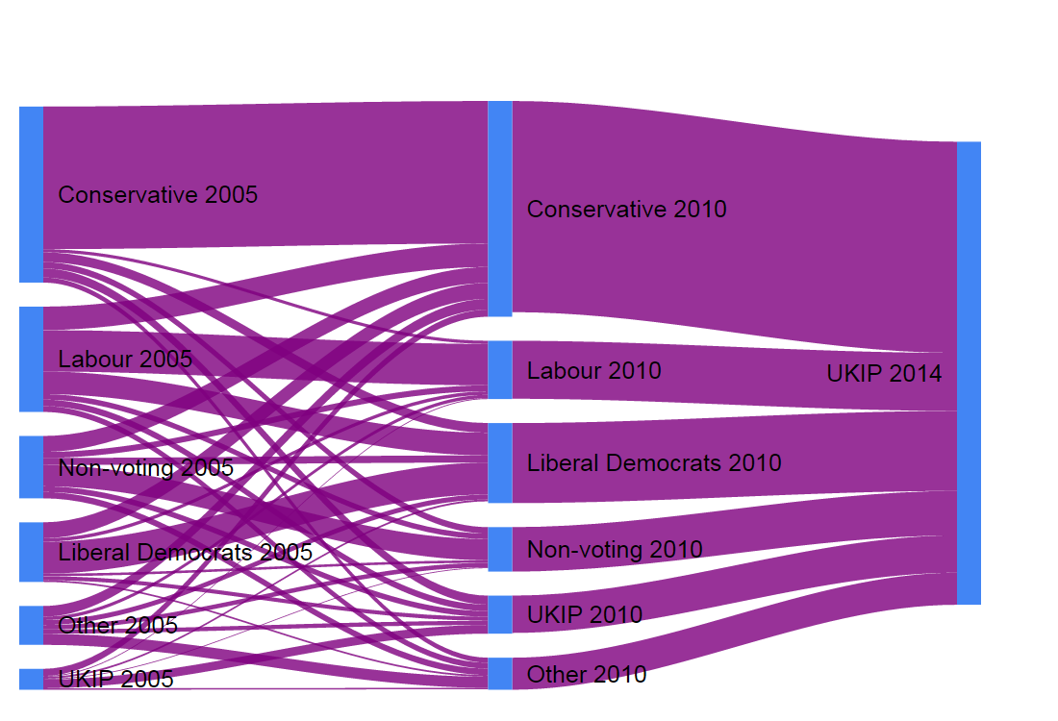
Pathways to UKIP
www.britishelectionstudy.com

Slide 3
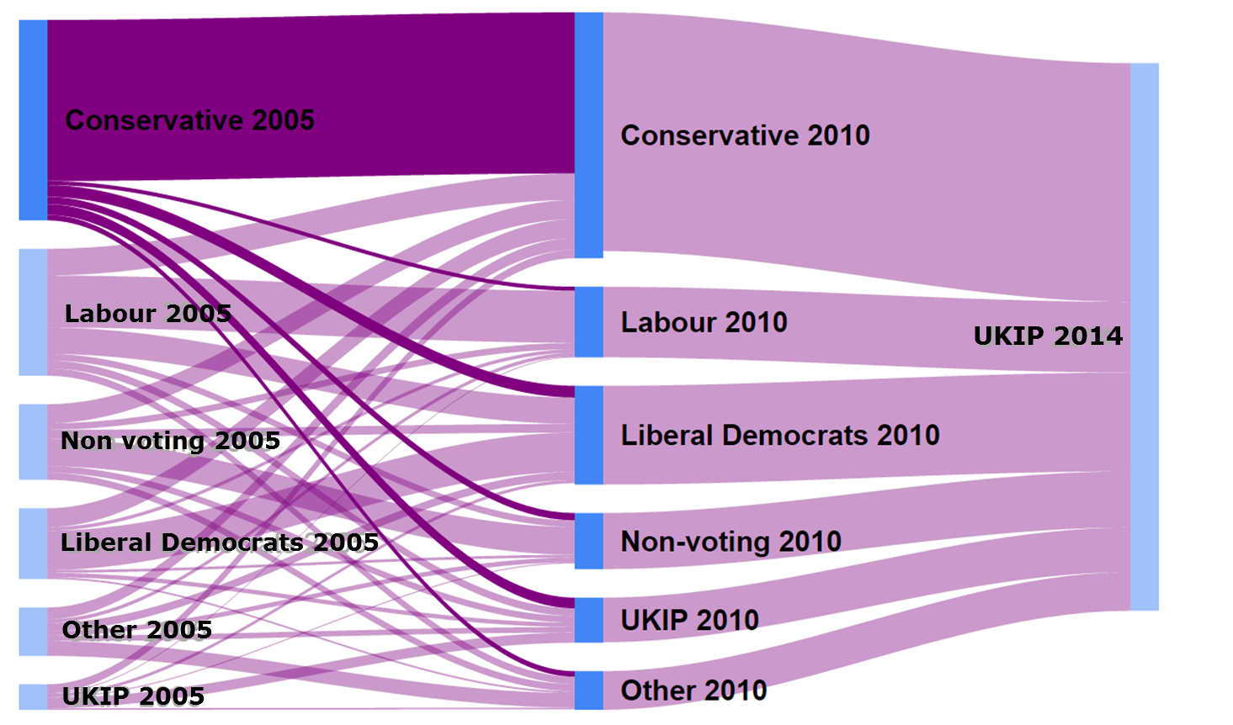
Conservative paths to UKIP
www.britishelectionstudy.com

Slide 4
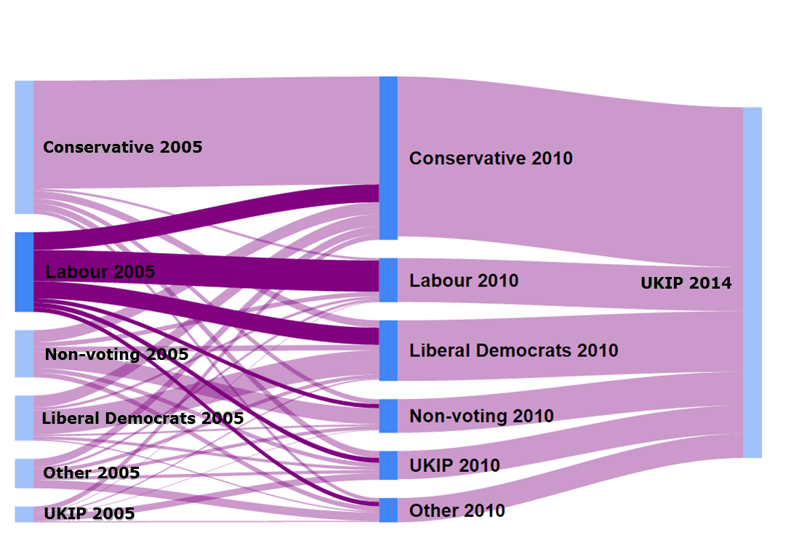
Labour paths to UKIP
www.britishelectionstudy.com

Slide 5
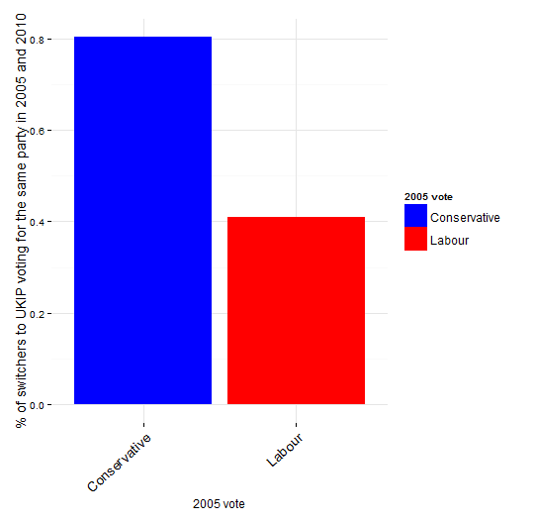
% of overall UKIP support occurring after 2010
www.britishelectionstudy.com

Slide 6
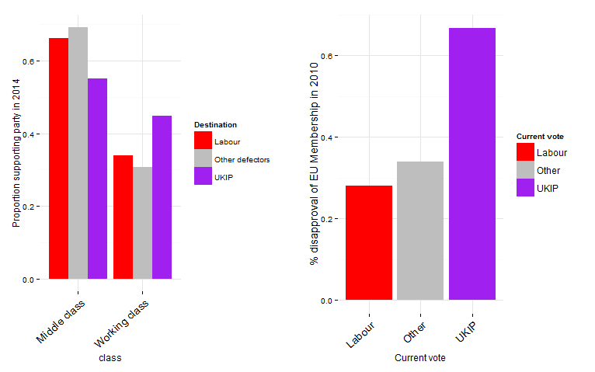
Class and EU effects on
Labour defection to UKIP
www.britishelectionstudy.com

Slide 7
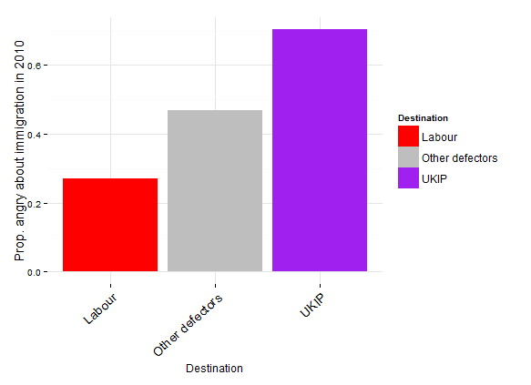
Anger about immigration among Labour 2005 supporters
www.britishelectionstudy.com

