Slide 1


The importance of the Europe question
Hermann Schmitt
University of Manchester
www.britishelectionstudy.com

Slide 2

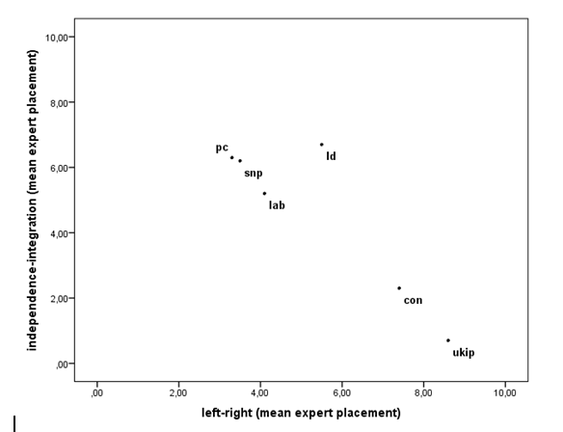
The Location of British Parties in 2014
Source: BES Expert Survey 2014
www.britishelectionstudy.com

Slide 3
The Predictive Power of Left-Right and Europe for the Probability of Voting For One of the UK-wide Parties
(figures are percent of the variance in vote probabilities accounted for)
 | Conservatives | Labour | LibDems | UKIP | Greens
1 Left-right dimension (LR) | 51 | 35 | 20 | 40 | 28
2 Integration-independence dimension (EU) | 10 | 21 | 14 | 32 | 20
1+2 | 53 | 40 | 26 | 47 | 34
Increase in (1) when (2) is added | 2 | 5 | 6 | 7 | 6
Source: Wave 3 of the BES 2015 Internet Panel
www.britishelectionstudy.com

Slide 4
Three Lessons
Europe while integrated in the Left-Right dimension is not all of it. Overall, there are more important meaning components than that.
The Conservative electoral potential is the least affected by Europe.
For the UKIP potential, Europe is probably as important as, if not more than, other LR meaning components.
www.britishelectionstudy.com

