Slide 1
How satisfied are voters with their MPs?
Philip Cowley
University of Nottingham
www.britishelectionstudy.com

Slide 2
How much trust do you have in…?
 | Members of Parliament in general | The MP in your local constituency
Low trust (1-3) | 56.2 | 39.1
Medium trust (4) | 21.0 | 17.8
High trust (5-7) | 20.0 | 33.3
Don’t know | 2.7 | 9.9
 | -31.4 | -5.8
www.britishelectionstudy.com

Slide 3
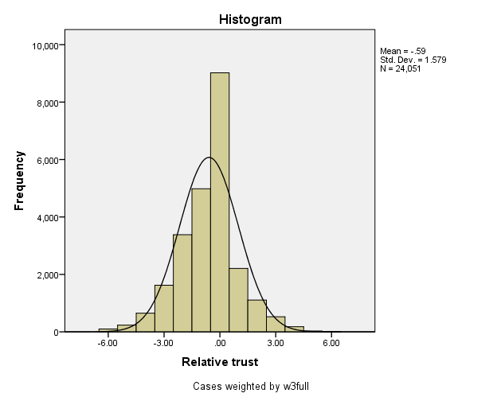
Relative trust
www.britishelectionstudy.com

Slide 4
Trust in your MP, by party
www.britishelectionstudy.com

Slide 5
Trust in your MP, by party and vote
www.britishelectionstudy.com

Slide 6
MP name recognition, by party
www.britishelectionstudy.com

