Slide 1
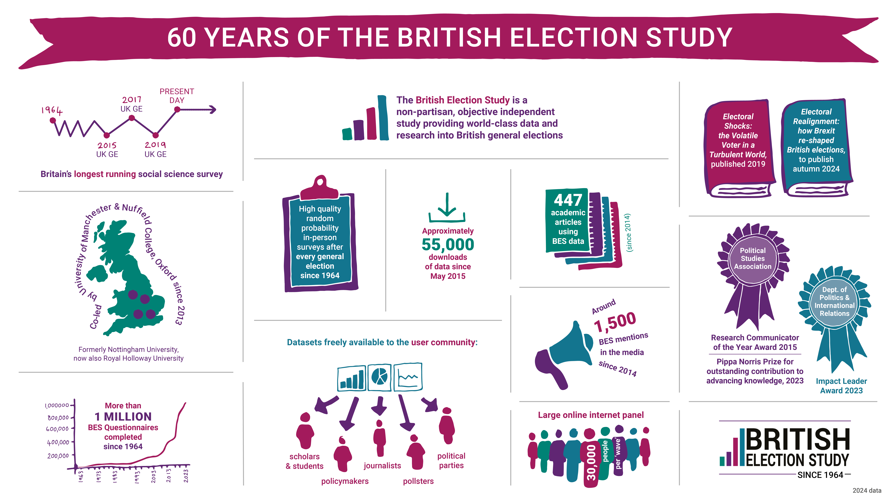

Slide 2

Realignment? Election 24 and the shadow of Brexit.
Lessons from 60 years of the British Election Study
Professor Edward Fieldhouse
University of Manchester

Slide 3



Slide 4
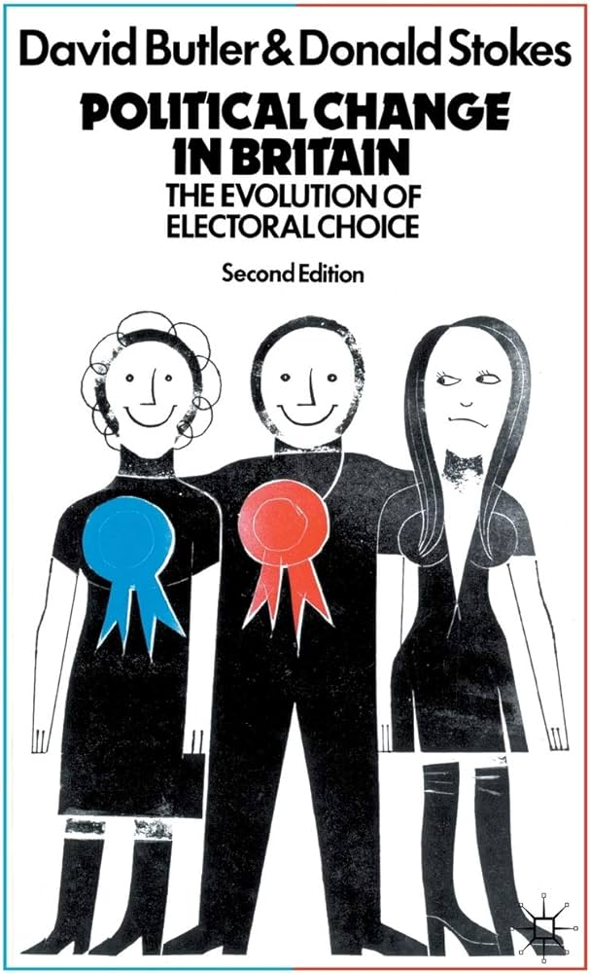
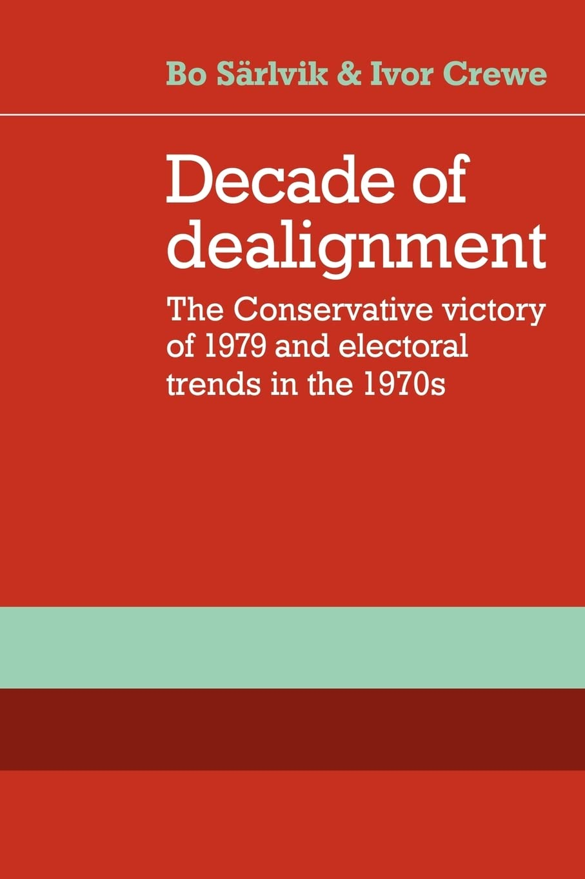
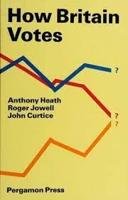
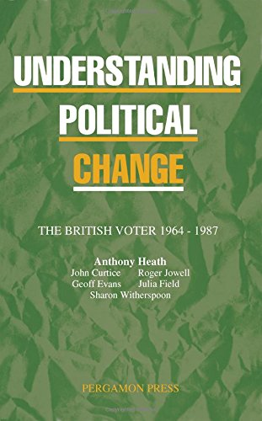
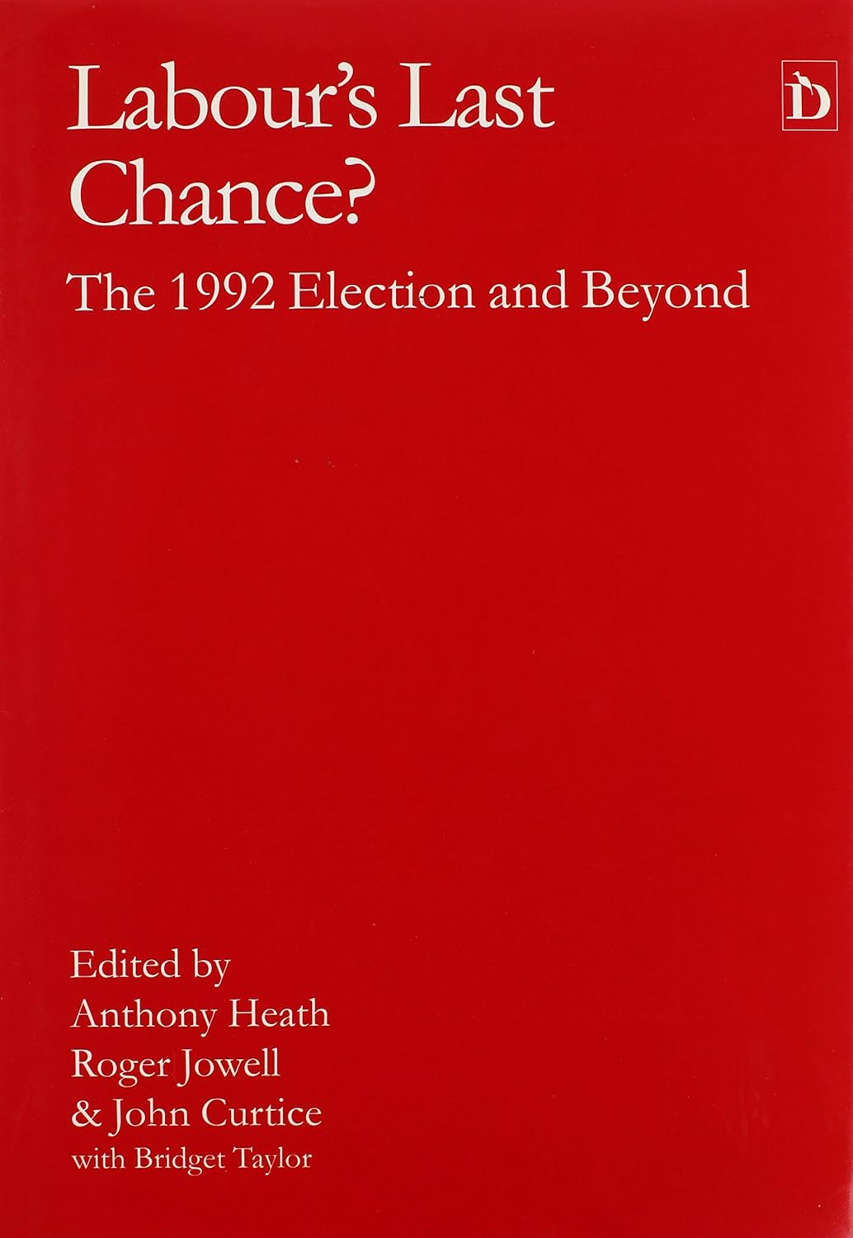
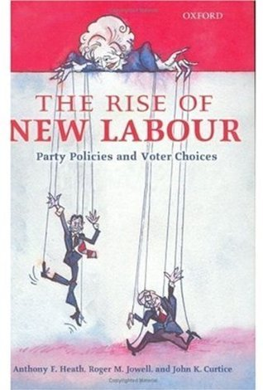

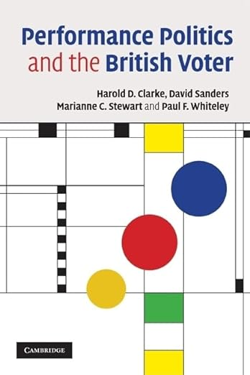
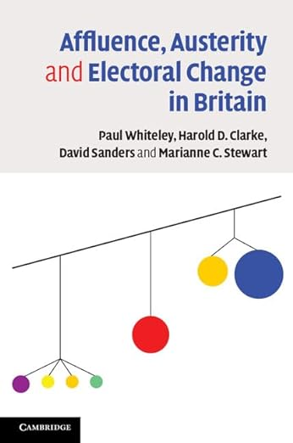

British Election Studies 1964-2024

Slide 5

2014-2019
Brexit Sorting

Slide 6
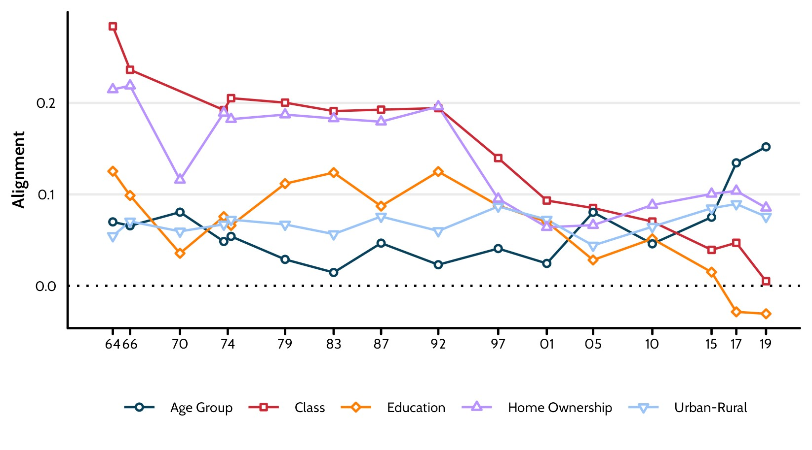
Long-term context: alignments since 1964

Slide 7
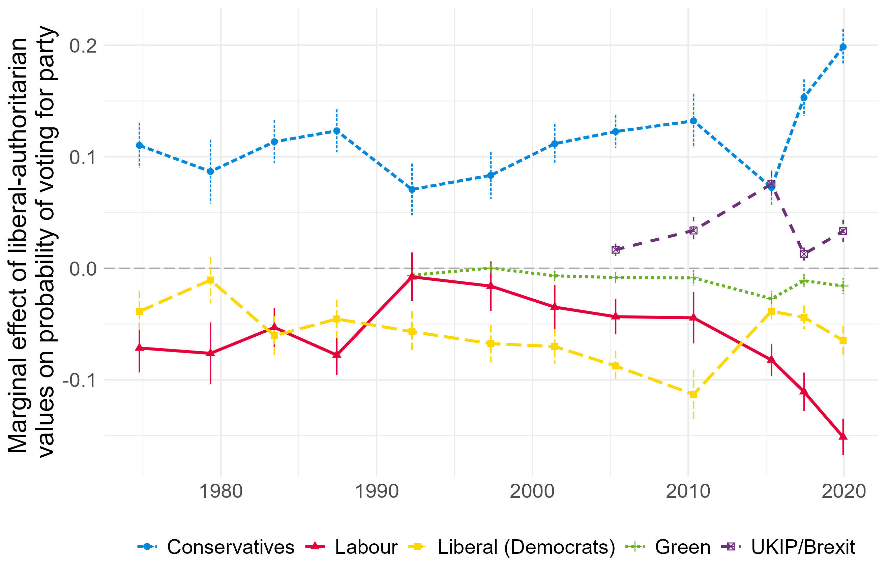
Liberal-Authoritarian and vote choice

Slide 8
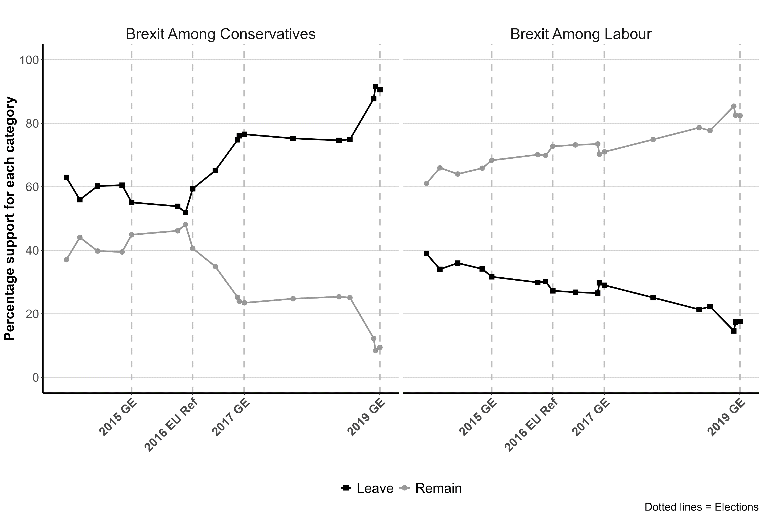
Brexit preferences of major party voters 2014-2019

Slide 9
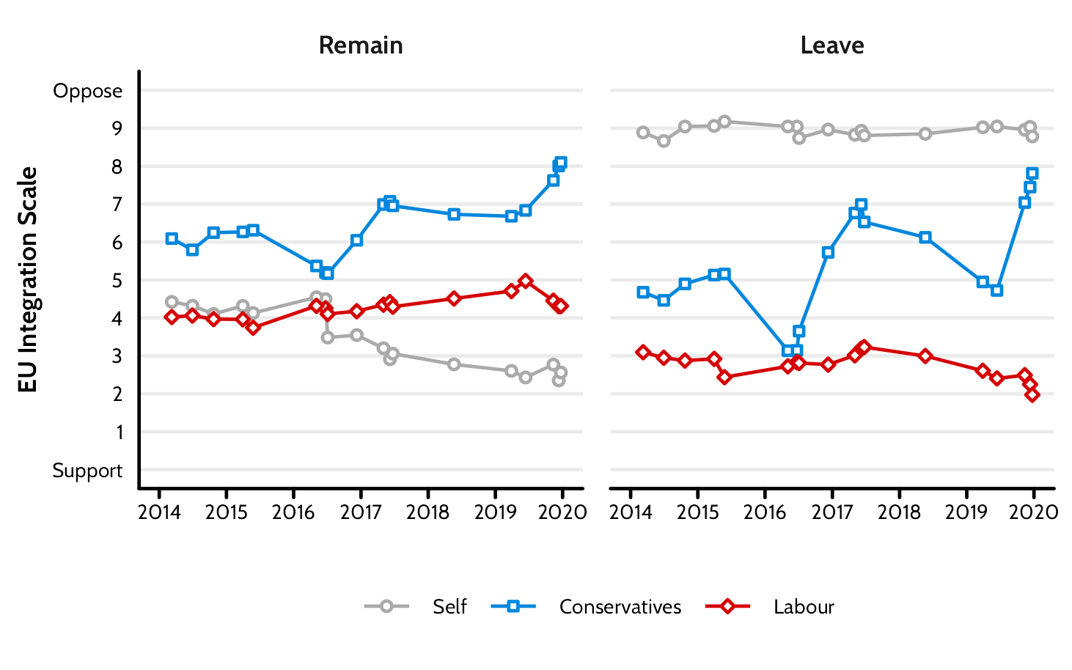
Changing perceptions of party positions on Europe

Slide 10

Election 2024.
Shocks, volatility and realignment

Slide 11
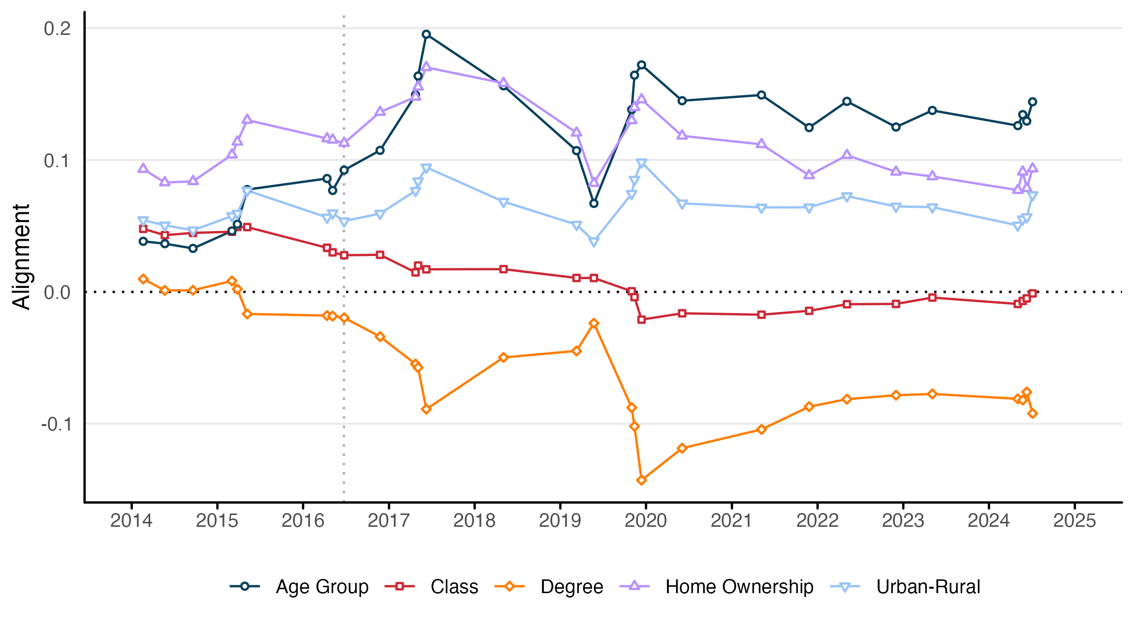
Realignment 2014-2024

Slide 12
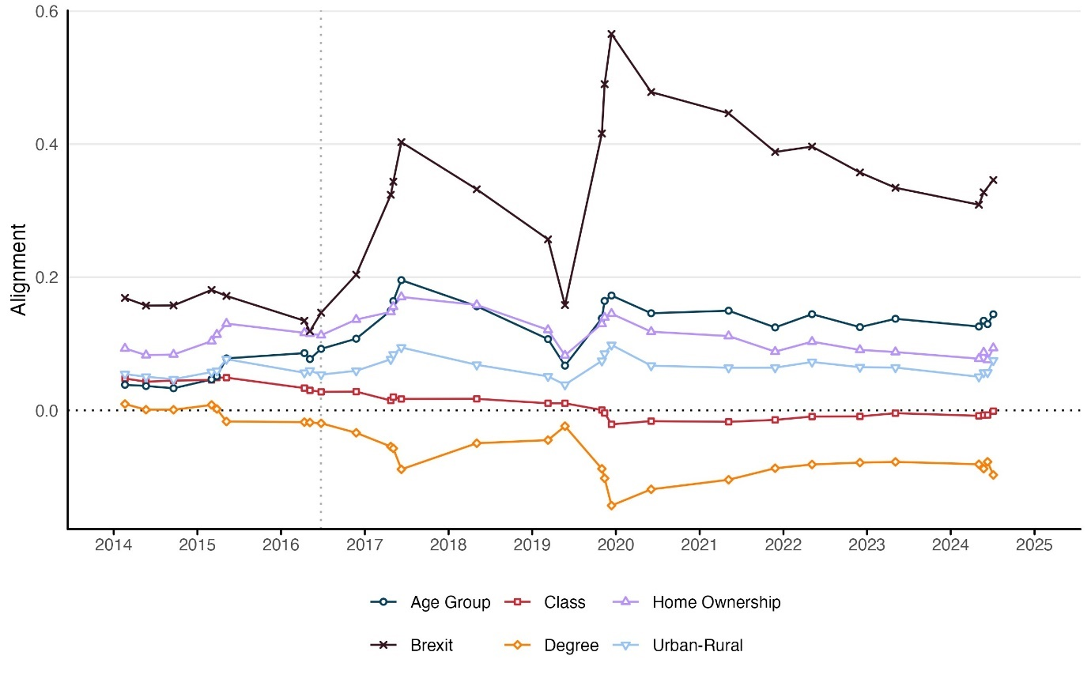
The two-party Brexit divide persists

Slide 13
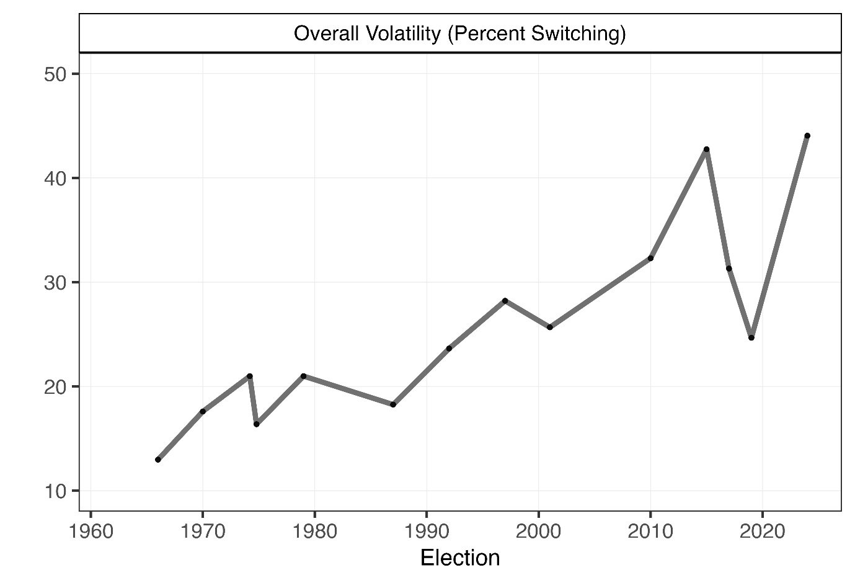
Volatility at highest level since BES began

Slide 14
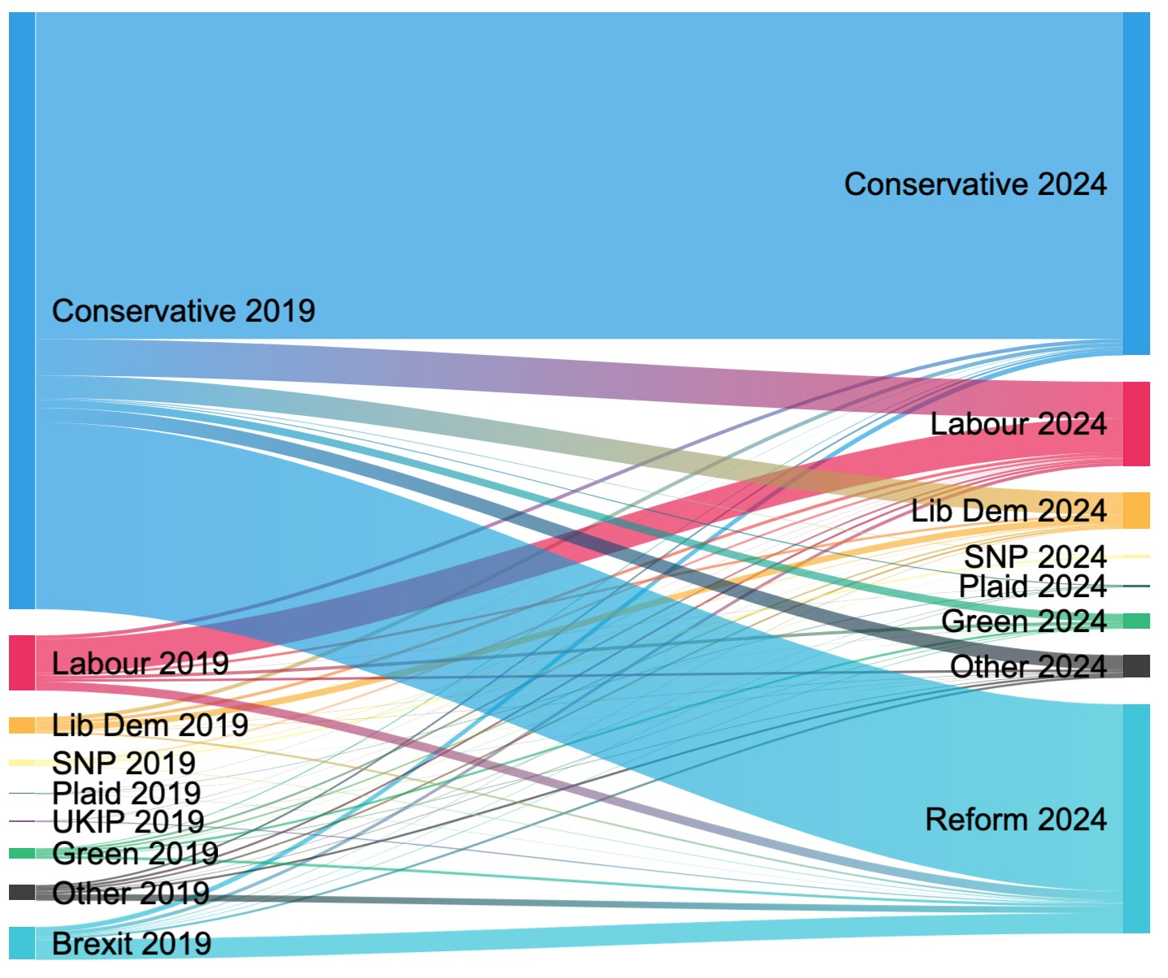
Vote switching 2019-2024 Leave/ stay-out

Slide 15
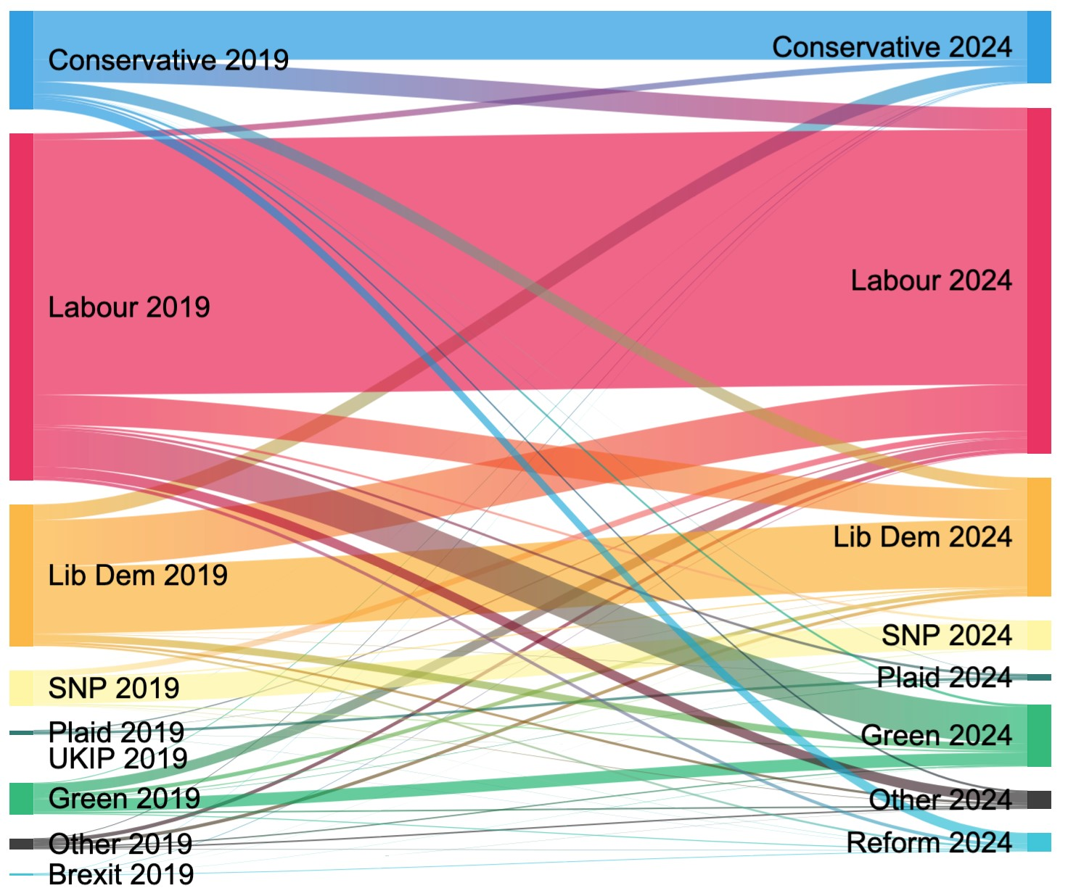
Vote switching 2019-2024 Remain/rejoin

Slide 16
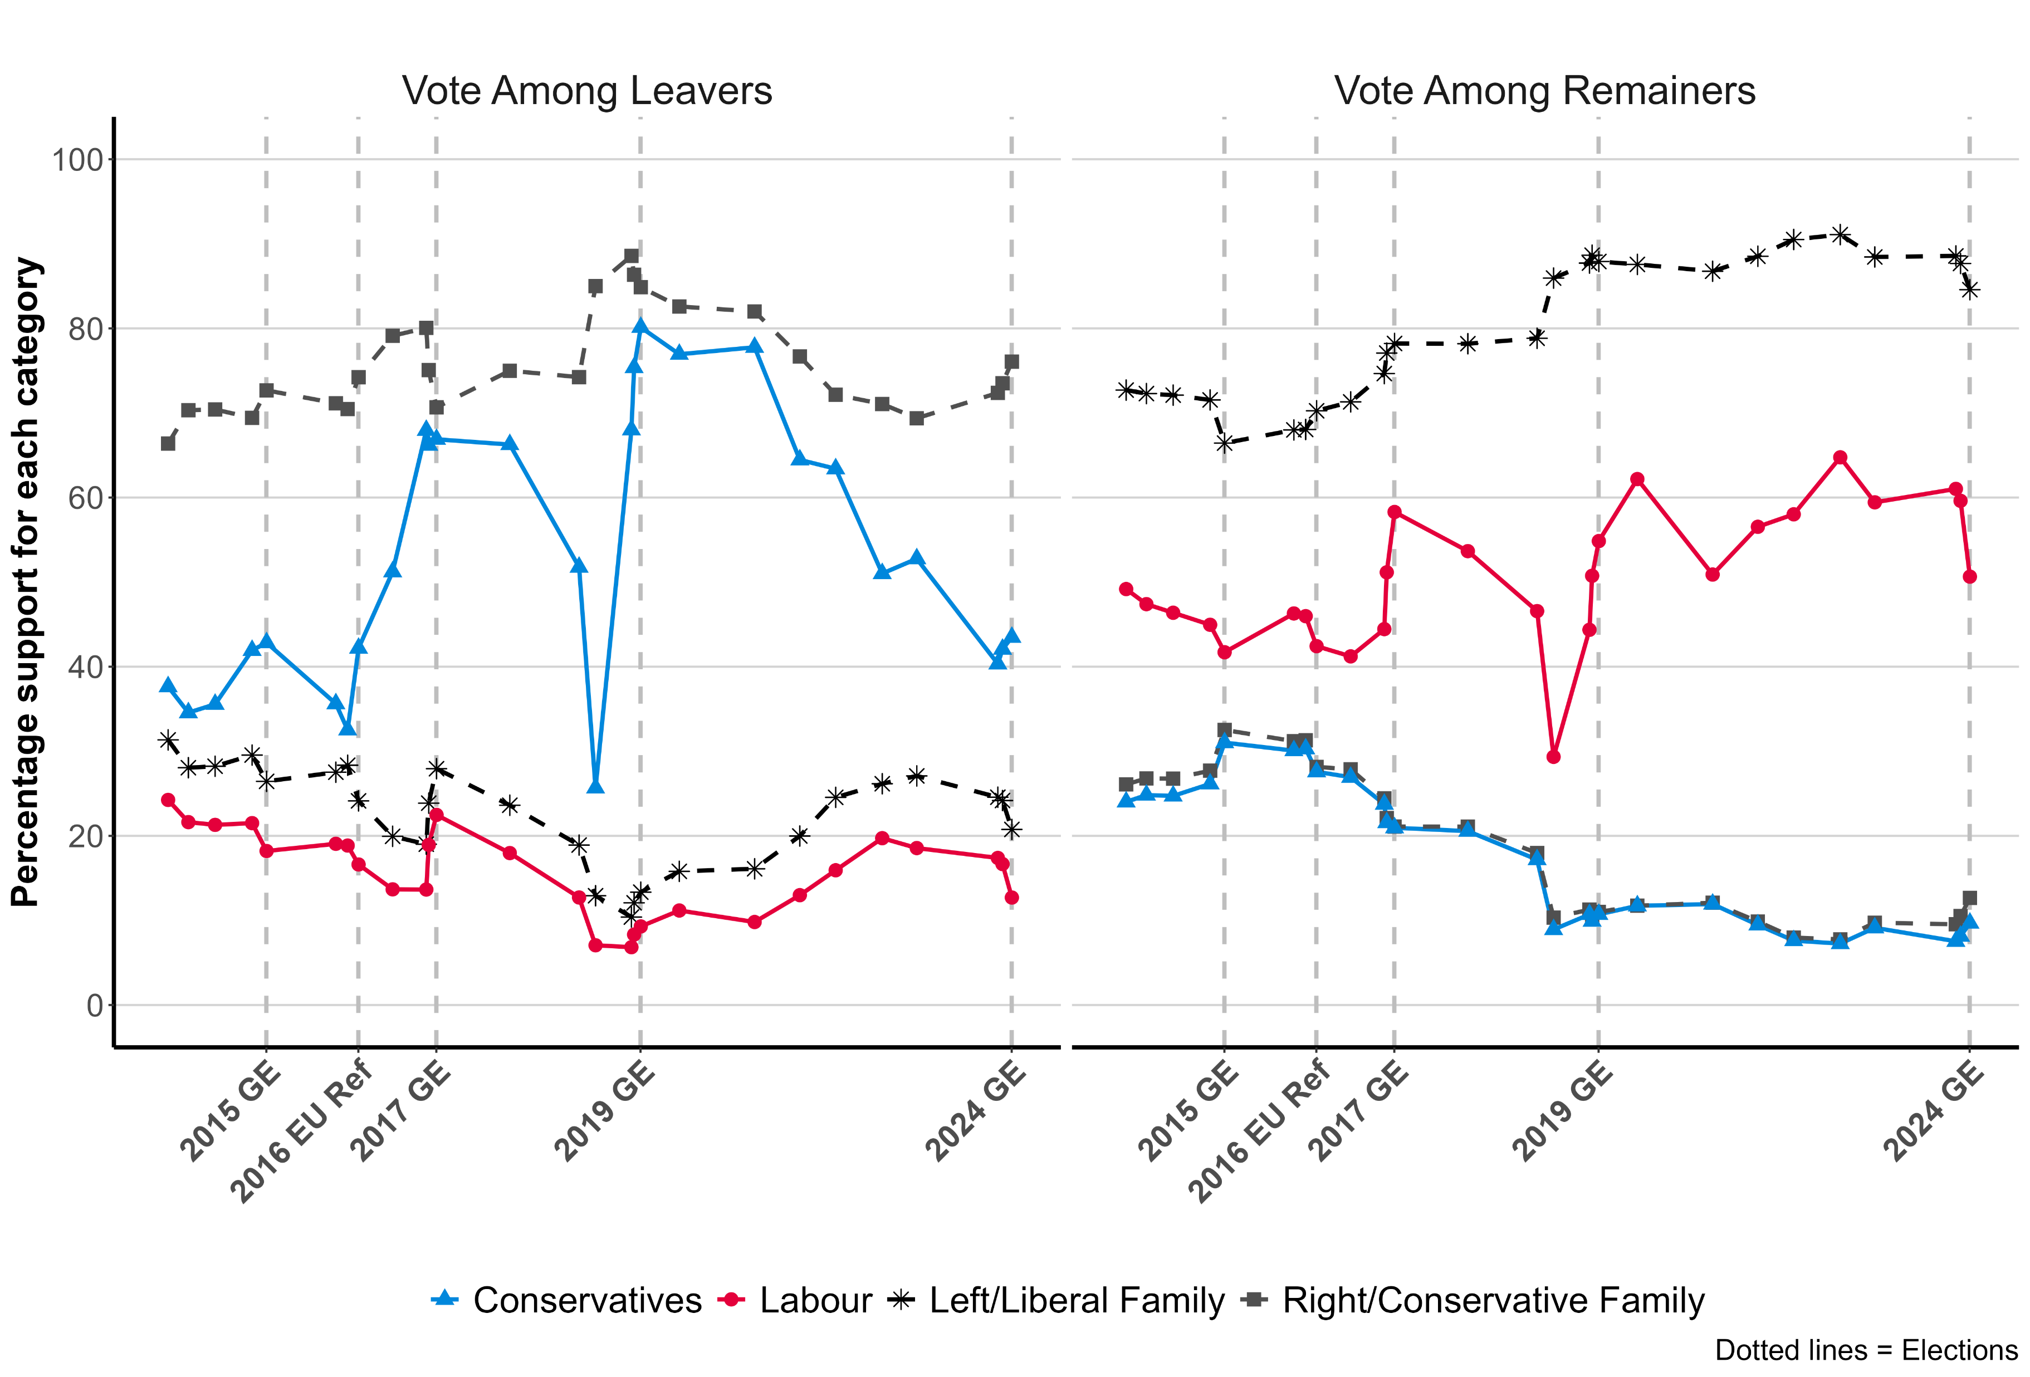
Brexit sorting by major parties and party families

Slide 17
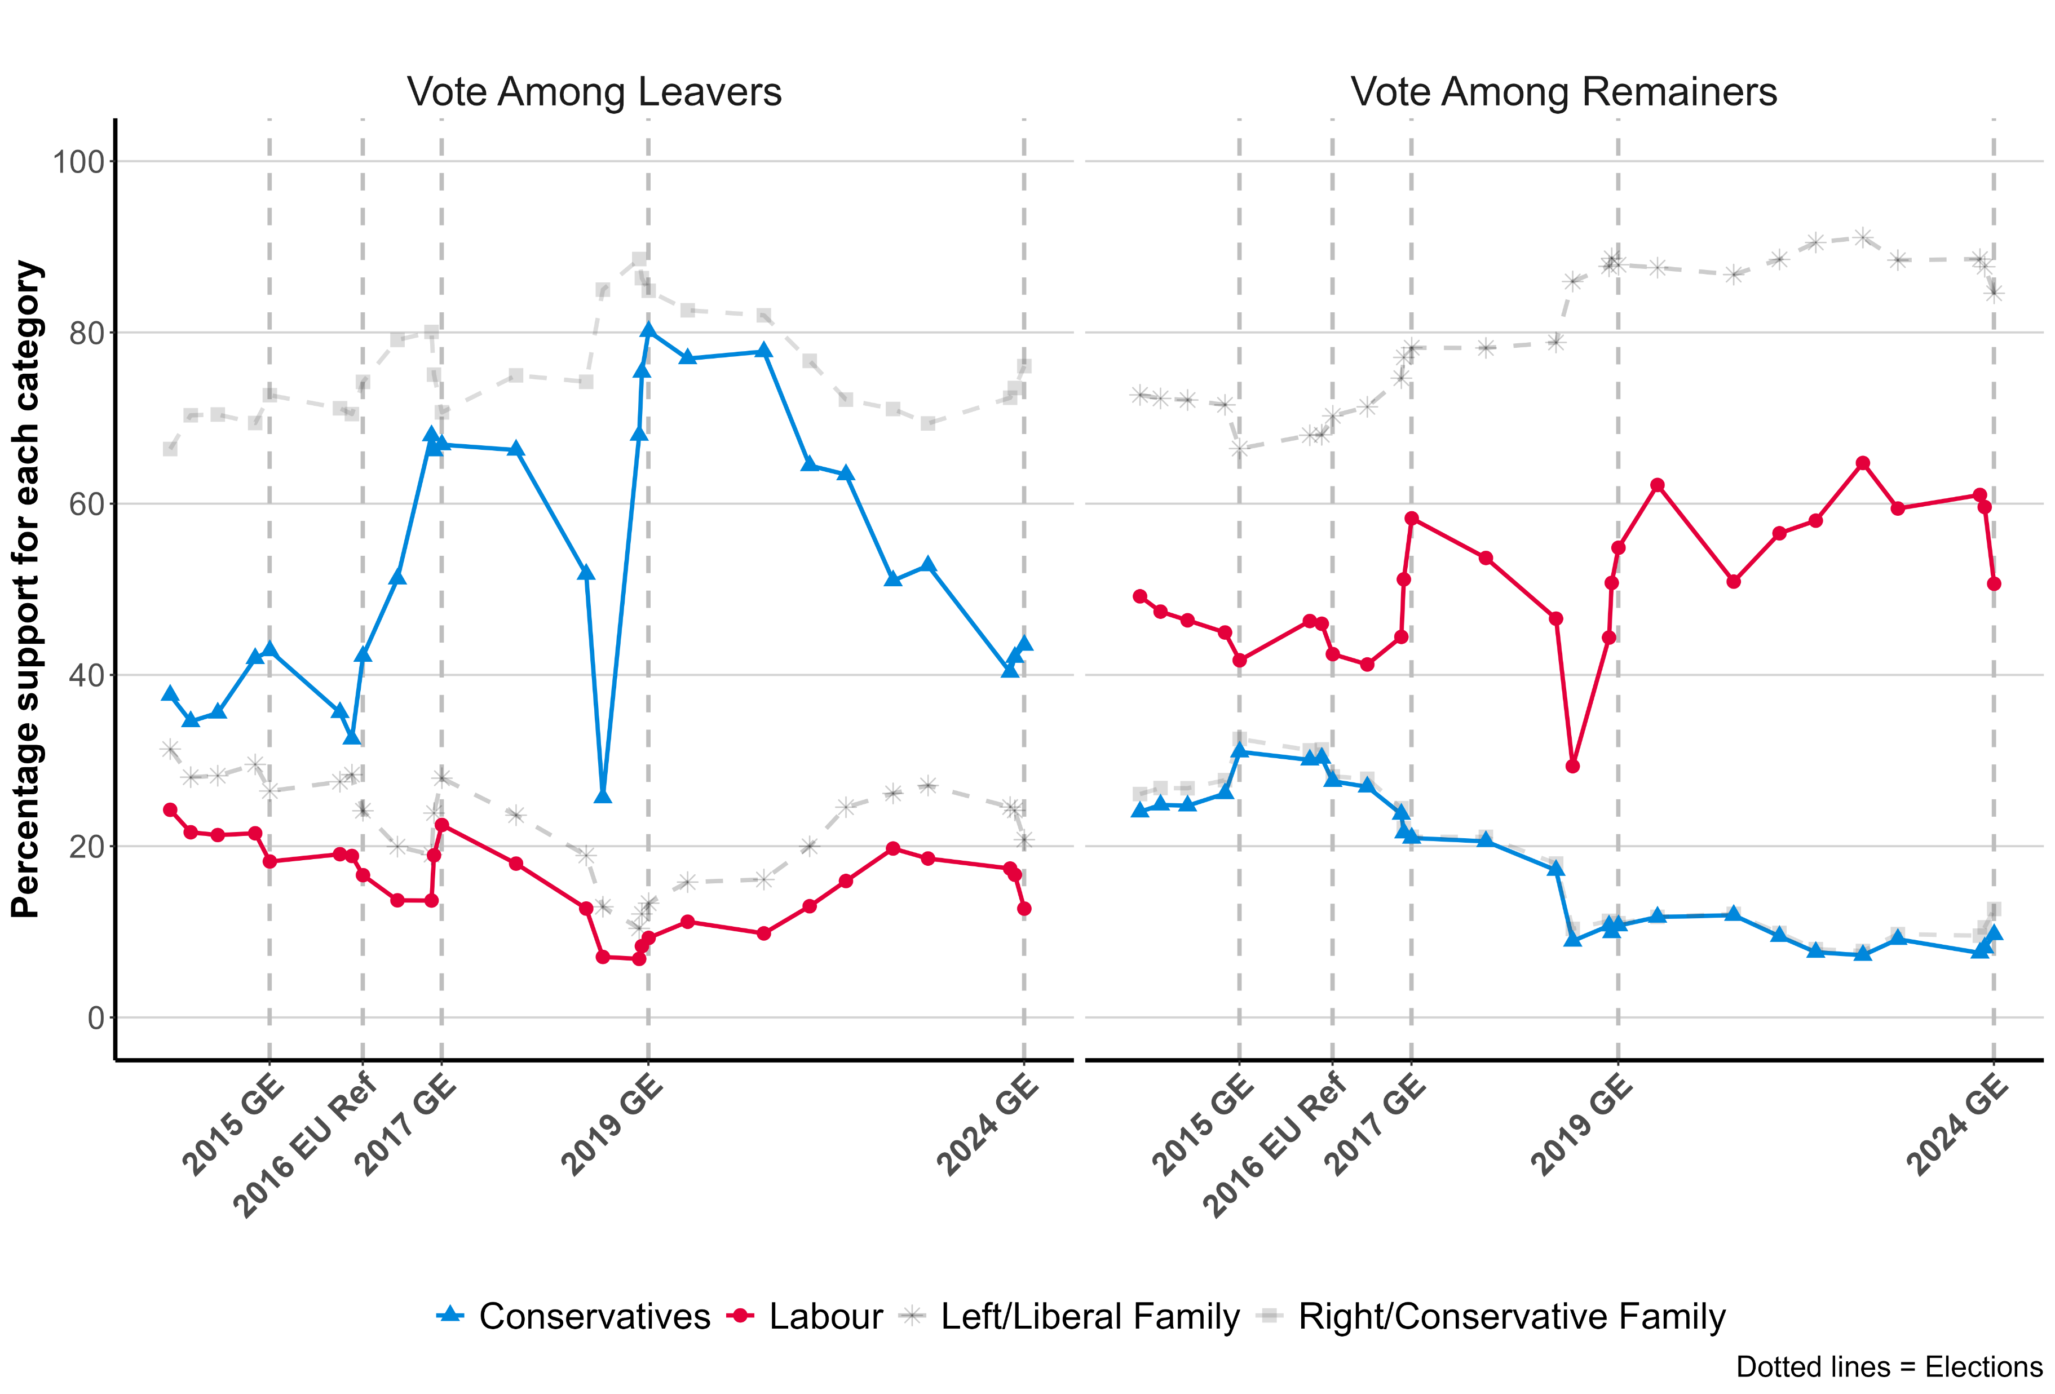
Brexit sorting by major parties and party families

Slide 18
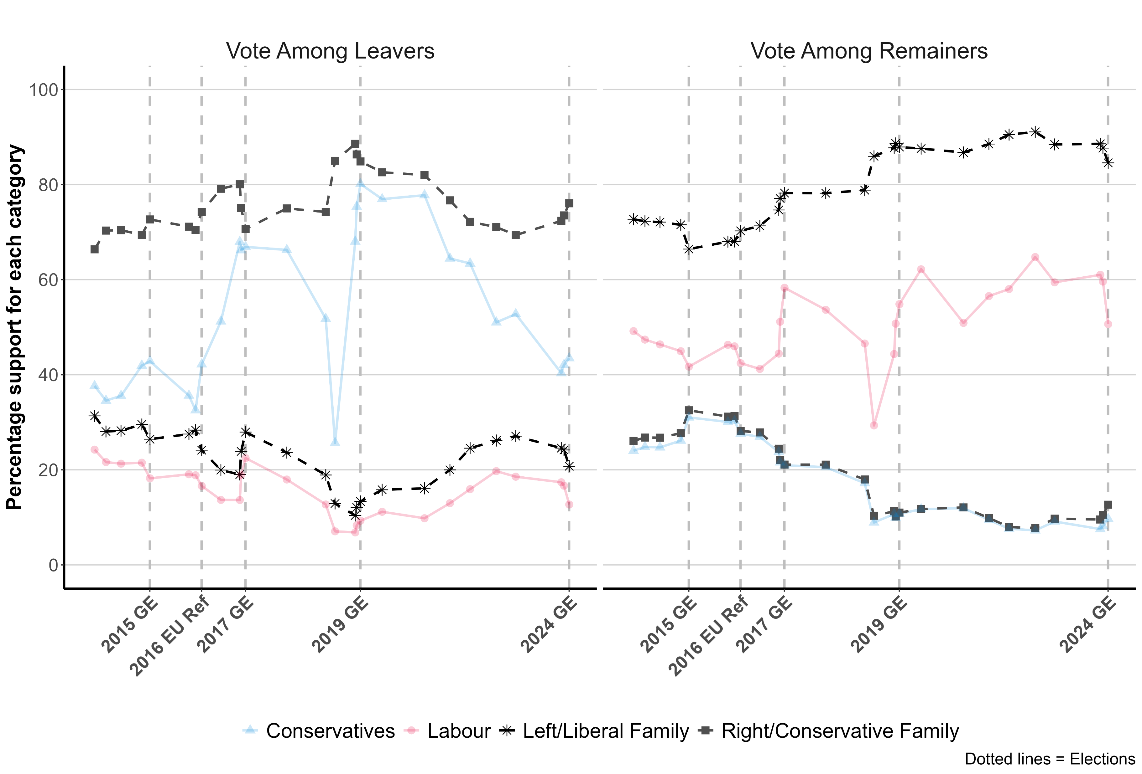
Brexit sorting by major parties and party families

Slide 19
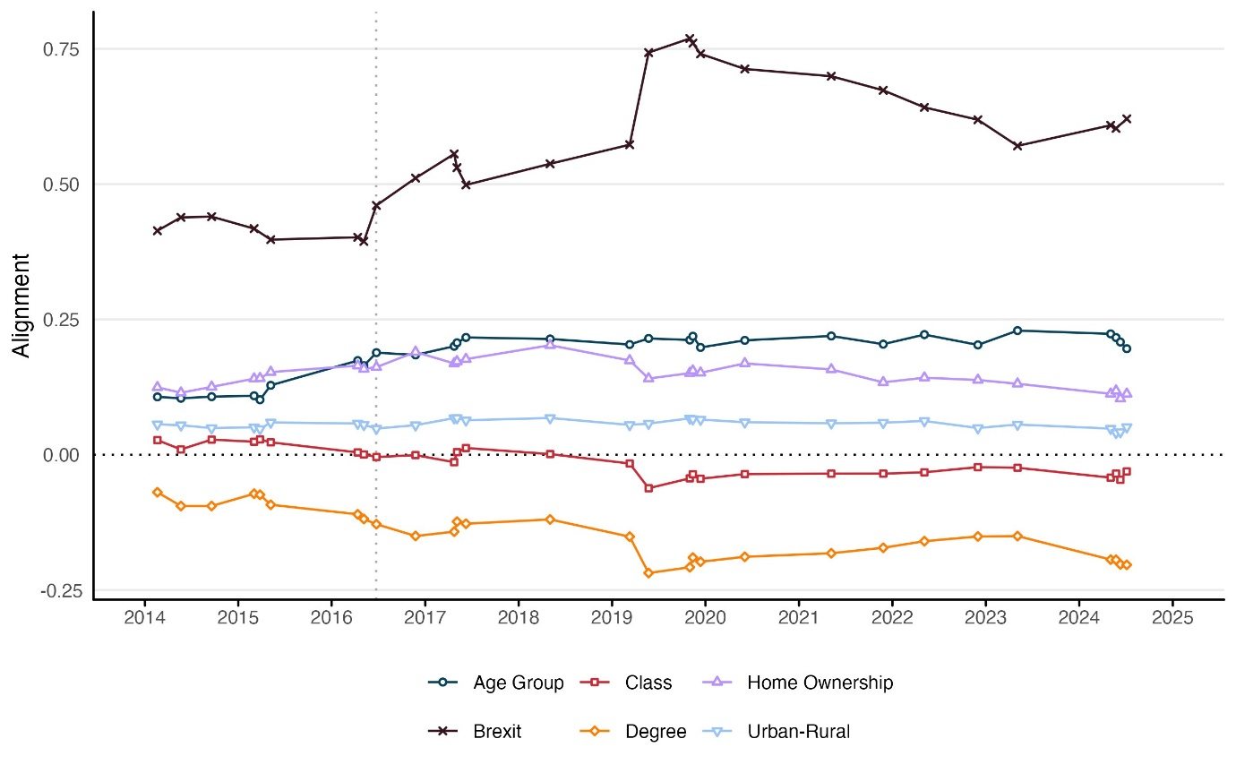
Party family alignments 2014-2024

Slide 20
End

